Slide 1
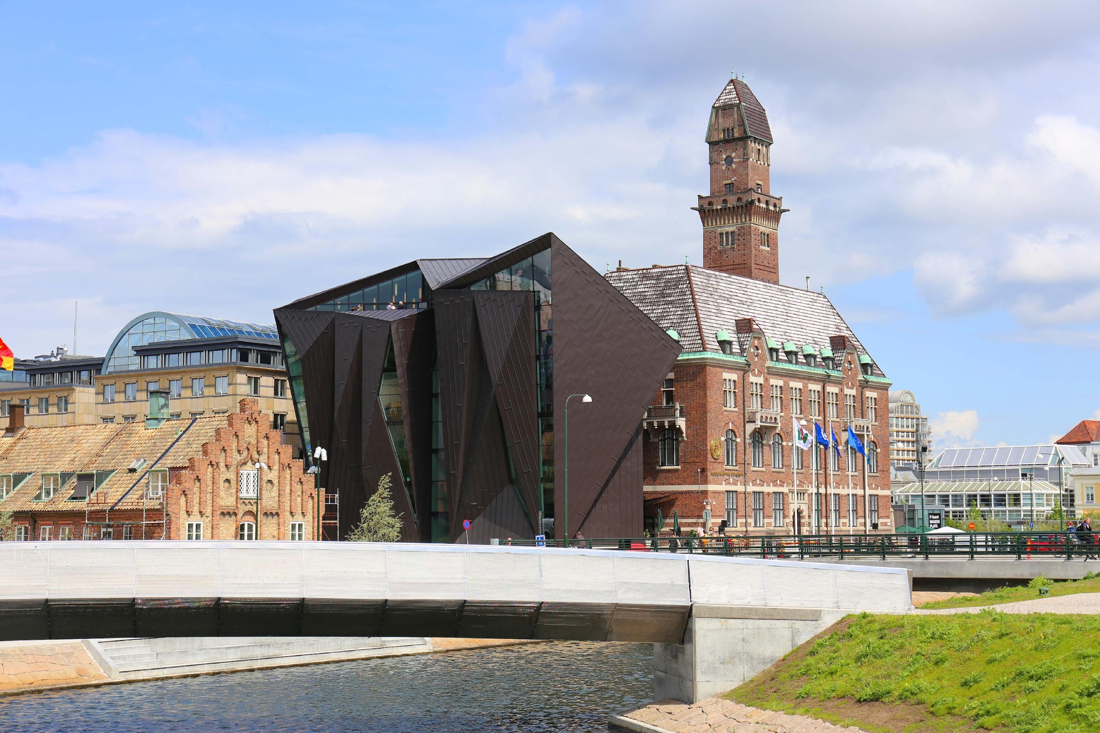
People. Development. Impact
Underwater Radiated Noise (URN) and Mitigation through PSSAs
Presented by
Musinguzi Brian
MEM S24 STUDENT
IMO-WMU Workshop on URN Reduction Policies with a Focus on Developing Countries • Session 3: URN Mitigation Solutions, Transferrable Practices and Role of Stakeholders • 15 – 16 October 2024

Slide 2
Assessing URN from Ships: Mitigation through Particularly Sensitive Sea Areas (PSSAs)
Aim of study
Research objectives
Assess URN sources, effects and mitigation solutions globally.
Feasibility of PSSAs to mitigate noise impacts.
Development of a URN management framework within a PSSA to boost its noise protection on habitat marine animals.
Application of the noise framework in the North Western Mediterranean PSSA.
To study URN sources and impact on marine animals.
To assess existing URN reduction measures and their policy trends in shipping.
To evaluate and improve the effectiveness of PSSAs in mitigating URN.

Slide 3
Underwater Radiated Noise (URN) and Mitigation through PSSAs
URN
URN Mitigation through PSSAs
Introduction
URN is a persistent habitat stressor amongst marine organisms characterized as the undesirable acoustic emissions generated by anthropogenic sources (Lalander et al., 2021).
Shipping generates noise between the frequency band of 10-300 Hz which could go up to 25K Hz which lies in the communication range of marine animals (Johansson et al., 2023).
Impact on Marine Life
Interferes with communication, navigation, and social behaviour of marine species
PSSA (Particularly Sensitive Sea Area)
Areas that need special protection from IMO due to ecological, socio-economic, or scientific significance
Benefits
Provides a cost-effective strategy for states to safeguard delicate marine ecosystems
Challenges
Their efficiency in eradicating the noise threat is contentious due to URN inherent complexities
Notes:
URN is undesired acoustic emissions from anthropogenic sources like ships, shipping is now a main contributor of low freq noise between 10 – 300 Hz which could go up to 25k Hz, noise impacts include masking which is communication interference as highlighted in this workshop.
Due to the limited time, I will open another URN mitigation paradigm of area based management by applying PSSA’s to mitigate noise, PSSAs are…, the benefit is that PSSA provide cost effective

Slide 4
Effectiveness to PSSAs in URN mitigation
PSSA measures and shortfalls in noise eradication include;
Speed reduction
Larger engines & vessels with CPP could still generate more noise at slower speeds (Bahtiarian, 2019, Vakili et al., 2023).
Also noise exposure is prolonged because ships spend more time in the area.
Other noise sources
Fishing, military, and leisure activities are not regulated by IMO or PSSAs.
01
Rerouting / Avoiding the area
Sound travels further and faster in water than air.
Ship noise reduced Blainville beaked whales foraging up to 5.2 km (Pirotta et al., 2012)
Awareness gaps
Noise threat not fully embraced globally.
Slow uptake of noise reduction initiatives by states.
03
02
05
Monitoring mechanism
No noise assessment process to assess the impact of the measures.
Unknown noise sensitivity thresholds of marine species.
04
Integrating systems theory into noise mitigation strategies requires establishing URN management system within a PSSA for noise mitigation.
Notes:
URN protective measures in PSSAs possess uncertainty to establish safe noise levels for habitat marine animals, the measures and shortfalls include;
1.Speed reduction; which is widely used but larger engines and vessels with controllable pitch propellers generate more noise even at slow speeds, also animals are exposed to noise for longer periods because ships move slower
2.Rerouting; its also applied but Sound travels faster and further in water than in air due to the high energy intensity in low frequency noise produced by ships, this is evidence of noise traveling upto 5kms or more
3.Monitoring mechanism; Unkonwn noise thresholds makes it difficult to set accurate noise targets and effective mitigation measures
4.Other noise sources from fishing, military vessels that are not regulated by IMO or PSSAs, theres need for Coordinated efforts are needed to protect PSSAs from all human-caused threats beyond shipping.
5. Awareness gaps that limit uptake of noise reduction initiatives
I applied systems theory in noise eradication that req establishment of URN mgt framework

Slide 5
URN management system for PSSAs
Analysis of the geographical area for internal and external noise pressures and devise tailored mechanisms for customized mitigation solutions.
Opportunity to apply noise regulations in PSSAs or specific areas with available biodiversity levels.
Application of ISO 50001 in URN Management system
Noise scope
ISO 50001 guides on how to improve the energy performance of an organization/system (ISO, 2018).
Requires integration of a Plan-Do-Check-Act (PDCA) cycle into the noise management framework.
Numerous sources of URN and marine species within a specified geographic area.
Opportunity to set boundaries of the system in terms of noise sources and habitat species that the system shall protect.
Notes:
The framework requires Analysis of the geographical area to understand internal and external noise pressures and devise tailored mechanisms to achieve safe ambient noise levels for habitat marine animals.
Also provides an opportunity to apply noise regulations in areas with known biodiversity levels
I applied the ISO 50001 that guides on how to improve energy performance of an organization to achieve set targets
The standard requires integration of a PDCA cycle into the noise management framework to achieve area based reduction goals
As you are aware, there are various sources of URN and many marine animals that are impacted differently in an area and need for specie specific noise objectives
Noise scoping provides an opportunity to set boundaries of the system in terms of noise sources and animals the system shall protect

Slide 6
PDCA Cycle for URN framework
Plan
02
Do
It involves setting URN policy, reviewing the URN, setting objectives and targets.
01
Designing of area and specie specific action plan and its implementation Schedules is at this stage
Do Phase
Planning Phase
ISO 50001
Requirement
Check
Act
Check Mechanism
Requires developing a robust noise monitoring mechanism in the PSSA and incorporate it with behavior context of existing marine species for effective monitoring.
Lastly, the review of the plan or stage system is done at this to ensure consistency of the measures with the system objectives.
Act stage
03
04
Notes:
As alluded above, this is the PDCA cycle for the noise system; Plan(policy,noise review, baseline, KPIs, objectives and targets ), Do(customized action plan and implementation schedule), Check(monitoring), Act(review of the system)

Slide 7
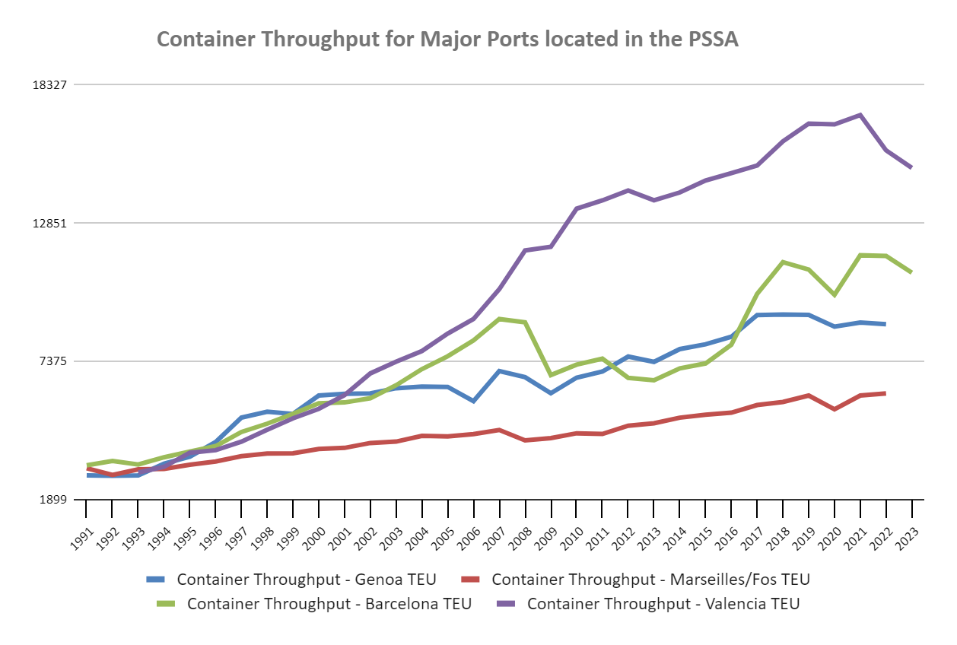
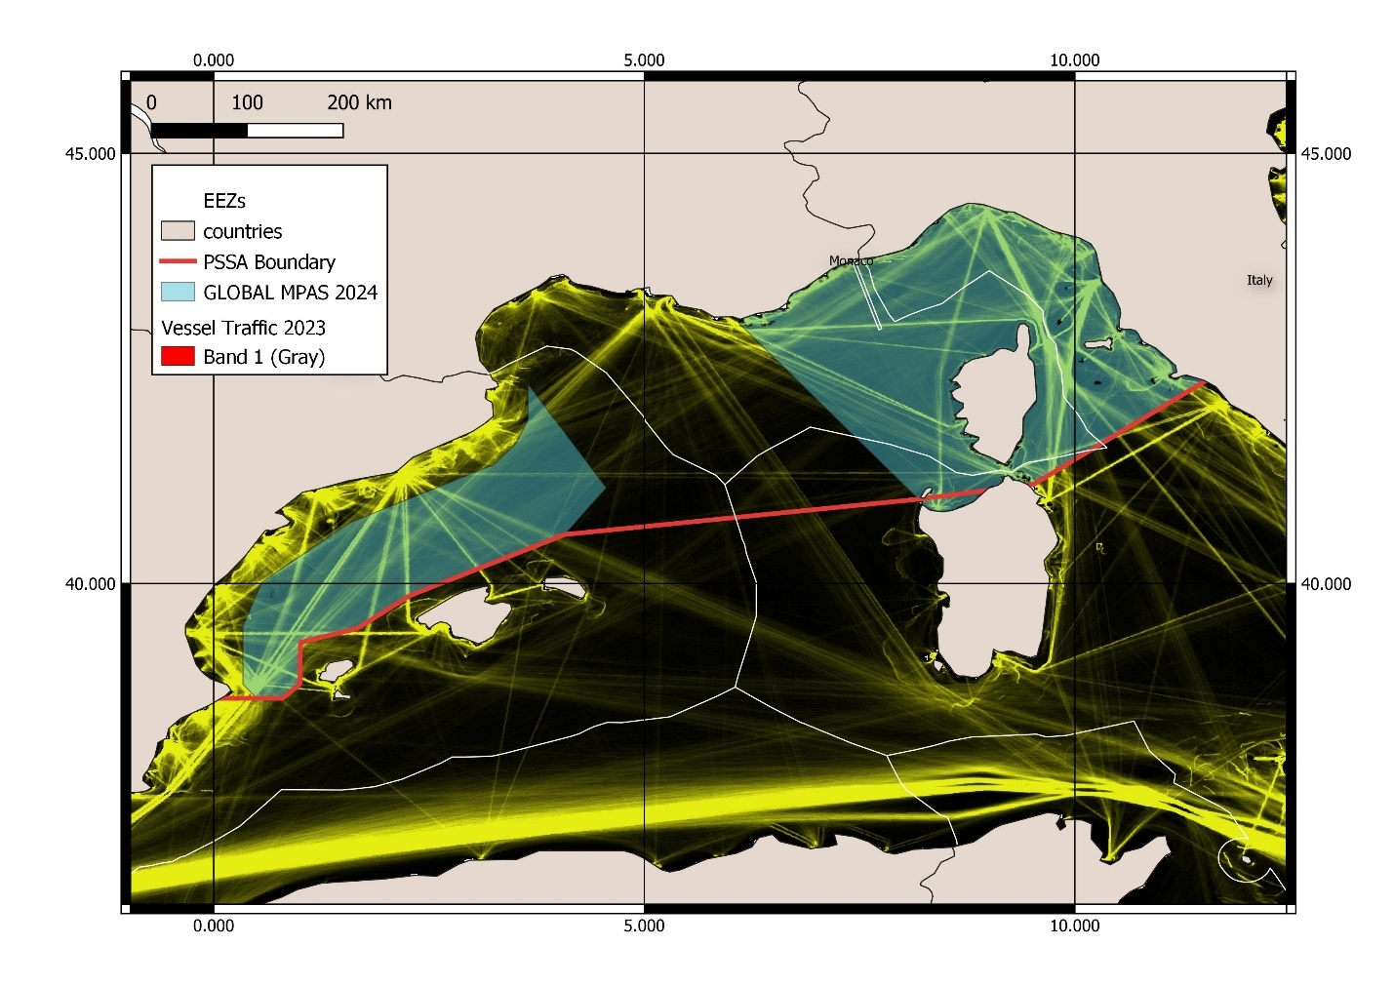
Application of the URN framework for North Western Mediterranean PSSA
Introduction
Noise threat
Noise system scope
Adopted at MEPC80 in 2023 by Spain, Italy, France, and Monaco.
Habitat for 21 marine mammal species, 750 fish species, 5 sea turtle species, and more than 360 breeding bird species.
8 cetaceans are frequently present in the area which include; whales (sperm, Cuvier’s beaked, fin and long-finned pilot whales), dolphins (common, Risso’s, bottlenose and striped dolphins) (IMO, 2024).
Vessel traffic has been on the rise in the area due to the geographical location of major shipping lines and major Ports in Europe including Barcelona, Marseille, Genoa and Valencia.
The noise plan covers noise from commercial ships
The system focused on Fin whales because they are endangered in the region according to IUCN red list and most sensitive species to noise (Castellote et al., 2012).
Notes:
In my research I continued to apply the developed framework on the North Western Mediteranean PSSA
As you maybe aware, the North Western Mediterranean PSSA adopted in 2023 at MEPC80 and its home for 8 marine mammals that are present all year and a wide range of biodiversity, it has significant threat of shipping noise from Ports like Barcelona, Marseille, Genoa and Valencia
The system covers shipping noise due to IMOs jurisdiction and fin whales due to their high sensitivity to noise but they are also listed as endangered in the region as par IUCN redlist

Slide 8
PDCA cycle for the NW Med PSSA
Plan Phase
Do Phase
Monitoring Phase
Act Stage
Creating a serene habitat for fin whales through enhancing their behavior communications in the area.
A comprehensive noise action plan of customized strategies to noise objectives includes policy related, technical and operational noise reduction measures.
Periodic URN measurement through installation of noise listening stations
A review process every five years to ensure continued policy alignment with the system objectives.
Noise Policy
205.6 dB – containers, 188.2 dB for bulker and 186.7 dB Tankers (Houweling et al. 2023)
Fin whales low freq sounds of 16-44 Hz, 183 dB in Širović et al., (2012)
Implementation entails a schedule detailing the specific timelines for the implementation of measures that facilitate a seamless transition within the system
Monitor behavior patterns in fin whales
Noise baseline & review
URN propagation/ship
No. of recorded vocal calls in fin whales/day
Establish a fin whale population survey and reports within 5 years
KPI
Reduce URN propagation of commercial ships;
Minimize masking in fin whales and other animals with the same acoustic threshold
Assessment of URN and fin whale population
Objectives & Targets
Notes:
As par the ISO 50001, this was my PDCA cycle that incorporated both area and specie specific noise reduction targets
For example the research’s noise target was to limit noise propagation in the area below 183 dB based on the scientific evidence of noise threshold among fin whales
The Do phase is where I established a comprehensive action plan of customized strategies from policy related, technical and operational noise abatement measures.

Slide 9
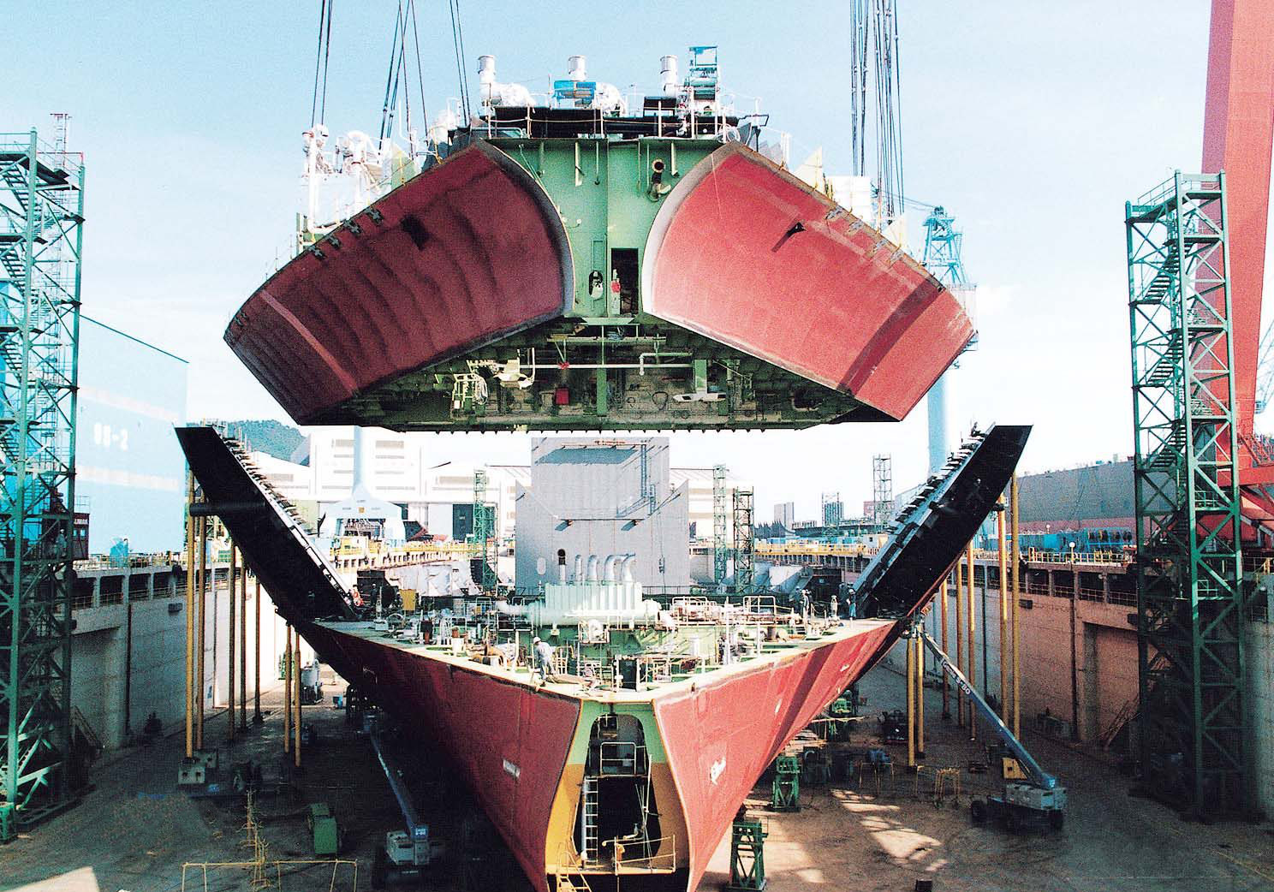
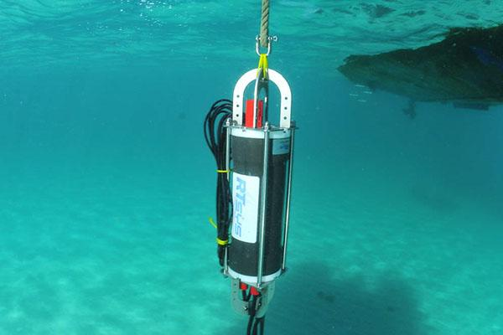
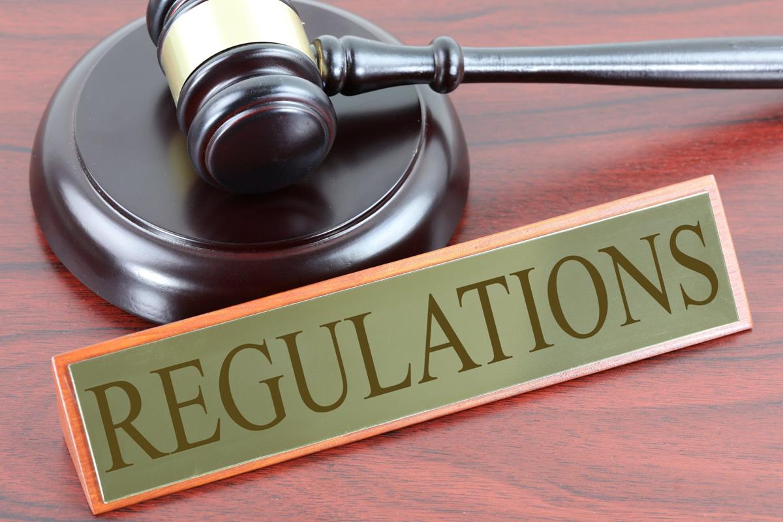
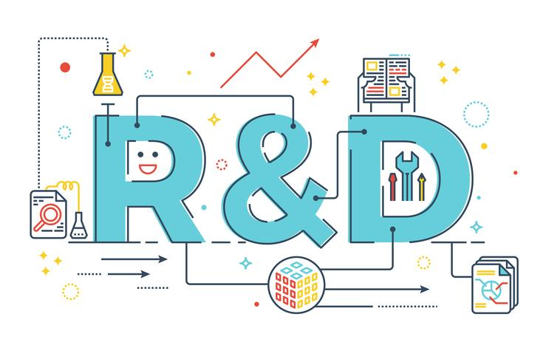
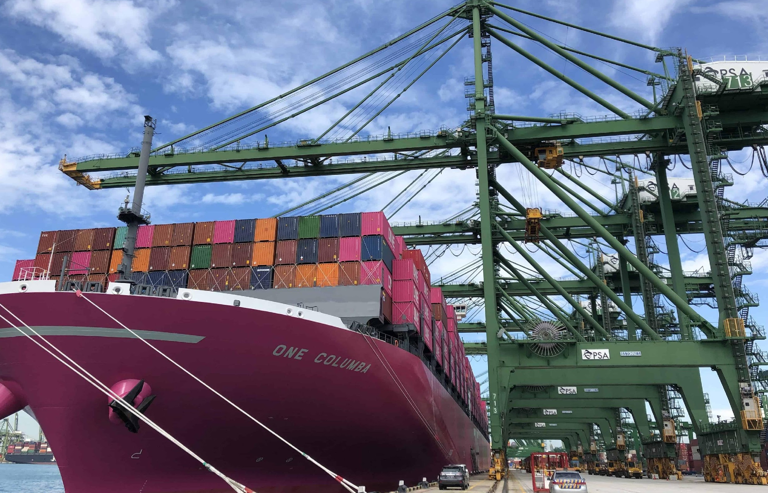
URN/ Measurements
Shipyards
NW Med PSSA
Stakeholder Management
Ports
Shipping
Noise Below 183 dB

Slide 10
Conclusions and Recommendations
Conclusions
Recommendations
International URN regulatory framework to drive uptake of noise reduction initiatives.
Enhanced scientific research on acoustic thresholds for marine fauna to obtain accurate noise sensitivity limits.
The continued uptake of GHG emission reduction initiatives shall offer significant URN reduction benefits that are however ship specific based.
Enhanced URN measurements to ascertain accurate noise reviews. On board acoustic propagation technology is required for ship-based noise targets.
The framework provides an opportunity for specie & area specific noise reduction goals.
Implementation barriers of such a framework have to be highlighted, from financial limitations to regulatory inadequacies, in order to devise viable solutions.
The role of stakeholder management is critical to unify all parties for a shared resolution.
Incentives for already burdened maritime sector with decarbonization efforts for uptake of noise abatement strategies.
Incorporation of this noise framework within the pre-existing marine management system.
Notes:
In conclusion; Its now possible to apply this framework for specie and area related noise reduction objectives with known noise pressures and impacts to animals
Cost, regulatory inadequacy and other potential barriers have to be highlighted for viable solutions
The maritime sector, which is already burdened by decarbonization efforts, requires support for the adoption of noise abatement strategies through incentives and reduced tariffs.

Slide 11
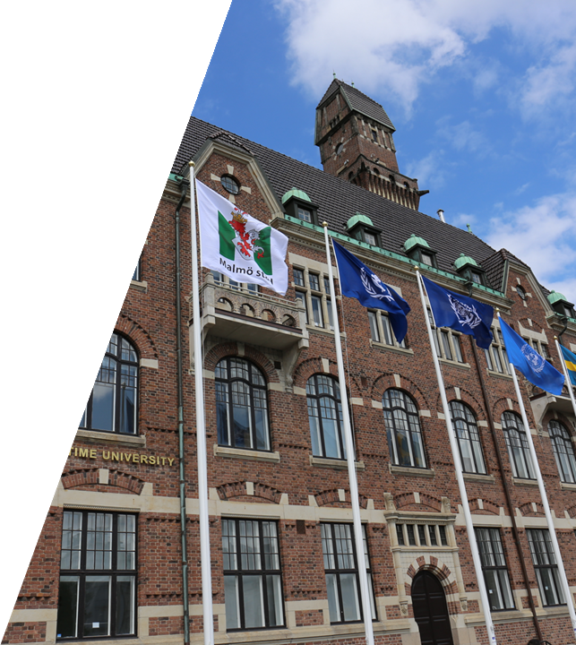
People. Development. Impact
Thank you for your attention!
Special acknowledgement to my Supervisor Dr. Aykut Olcer and MEM Department, Prof. Neat Francis, WMU and Germany Government and the
IMO-WMU Workshop on URN Reduction Policies with a Focus on Developing Countries • Session 3: URN Mitigation Solutions, Transferrable Practices and Role of Stakeholders • 15 – 16 October 2024

